Slide 1
Traffic Vision
Smart technology for safer intersections

Slide 2
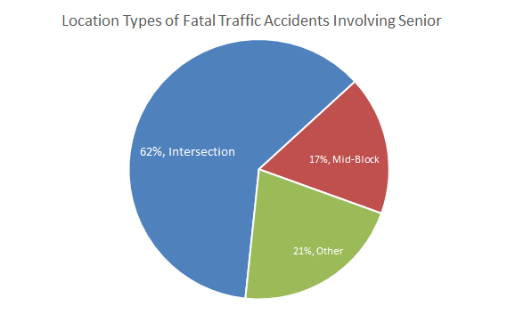
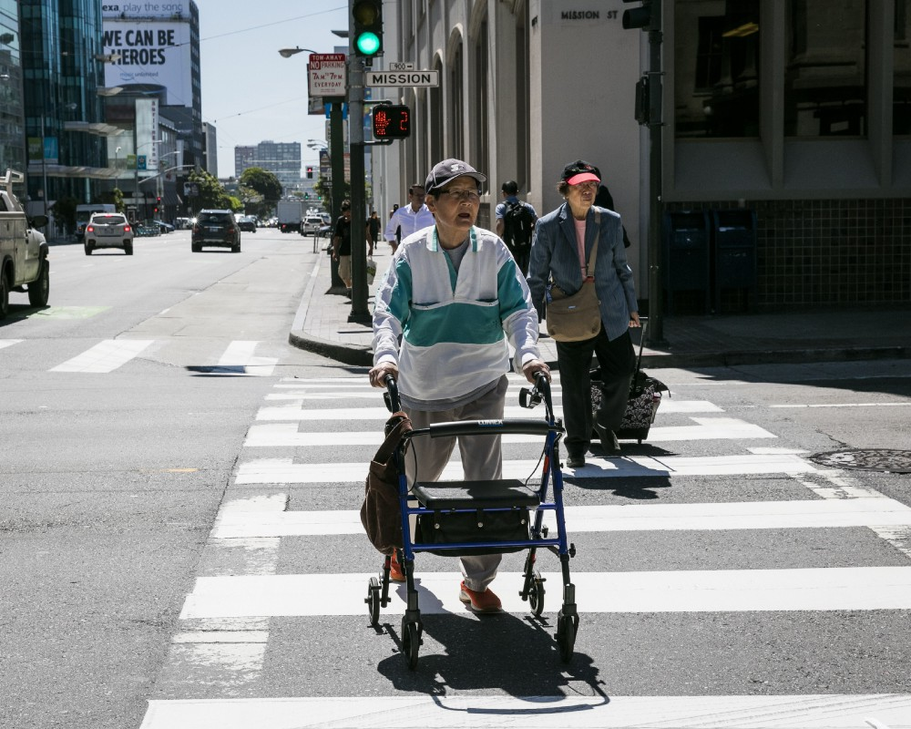
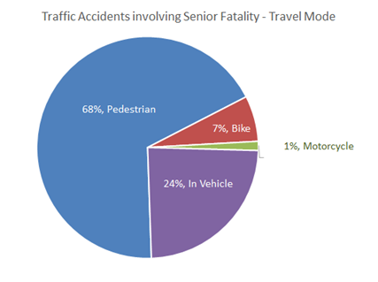
The Problem
Senior pedestrians are vulnerable at intersections
Photo: Adrienne Johnson/Human Streets
Notes:
Why is this a problem?:
Seniors are overrepresented in traffic accidents
40% of fatal collisions in Vancouver involve seniors
Decreased quality of life as they must worry about crossing, leads to isolation

Slide 3
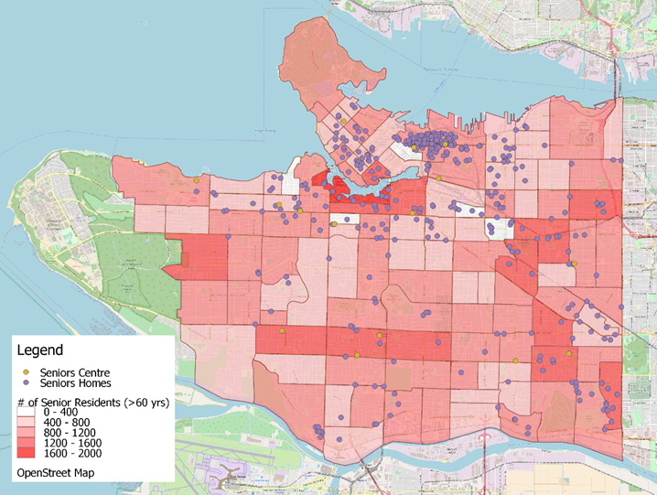
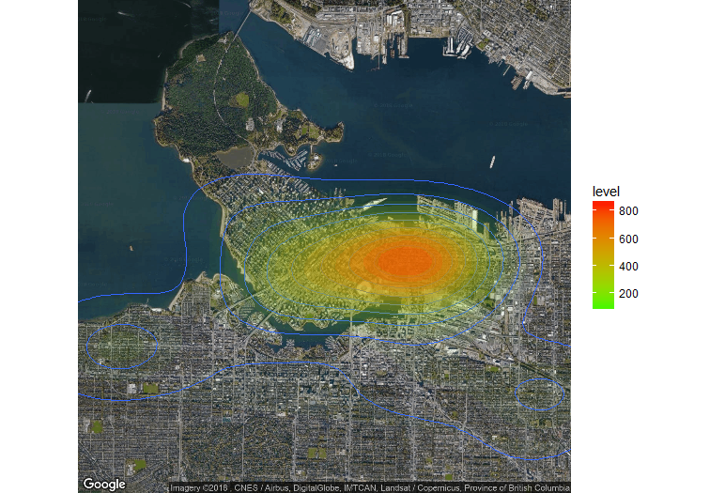
Where and why?
Senior Population and Senior Home Distributions
Mainly occurred around Hastings and Main
Fatal Accident Heat Map

Slide 4
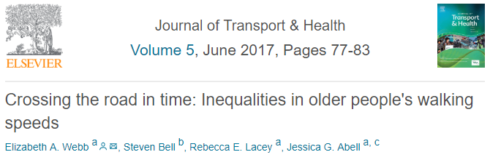
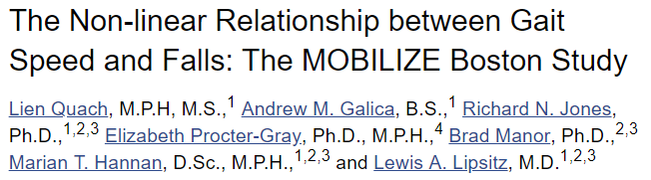
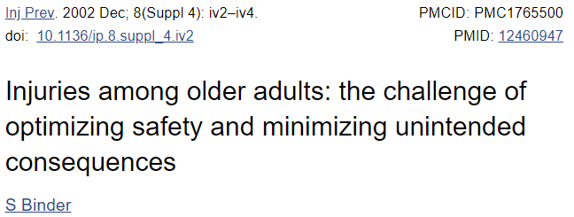
They need more time!
Pedestrian Signal Design Speed: ～1.0 m/s
Mean walking speed for senior: 0.9 m/s in men and 0.8 m/s in women
Faster gait speed is associated with an increase in risk ratio for outdoor falls
Notes:
The top three causes of injury related death for seniors (65+) in the United State are falls, those related to motor vehicle crashes, and suicide.
Note: The pedestrian walking speed used in these studies is 1.2m/s (international standard?), but in Canada it is mostly 1.0m/s.
https://www.sciencedirect.com/science/article/pii/S2214140517300464
https://www.bbc.com/news/health-18428042
This is still too fast for seniors and people with disabilities! Also, it creates a hazard if someone falls in the middle of the road
https://humanstreets.org/seniors-and-people-with-disabilities-demand-more-time-to-cross-the-street-df64f3bb72fe
-3.5 ft/s in San Francisco. Advocates want 2.5 ft/s

Slide 5
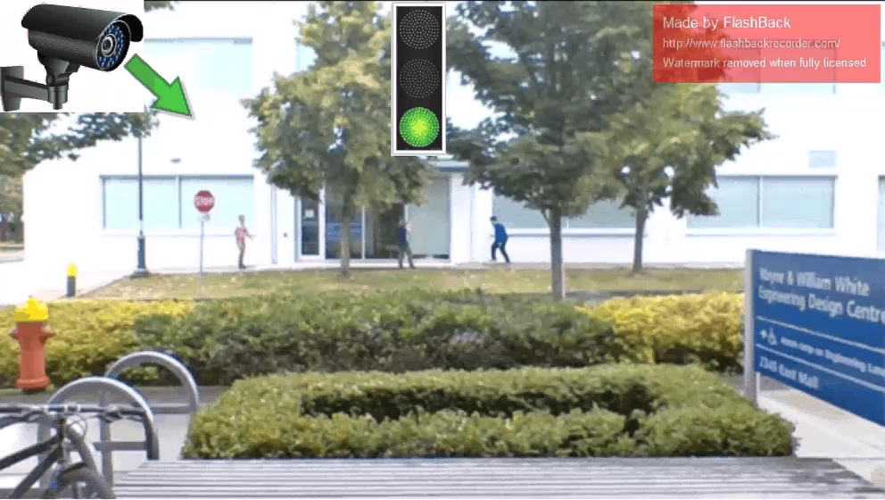
What we propose...

Slide 6
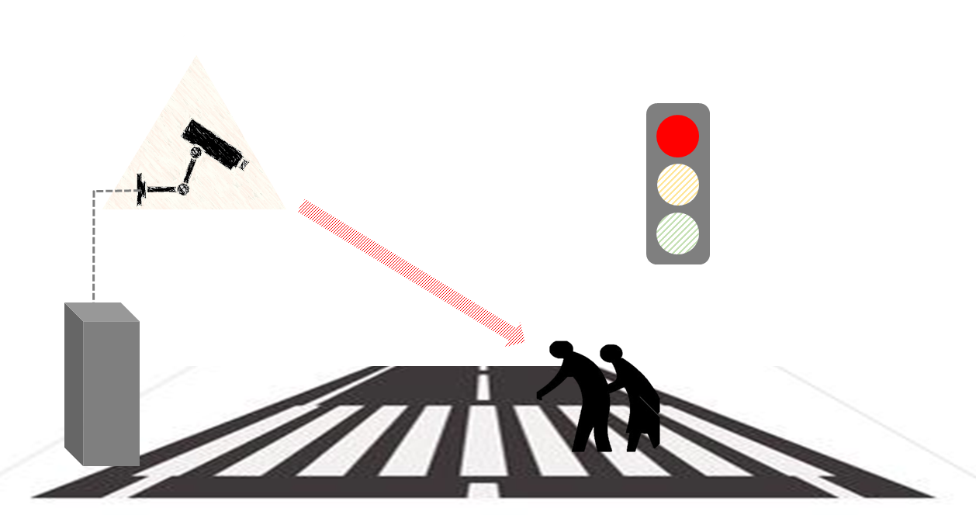
What we propose...
Extend pedestrian walking time when pedestrians with walking impairment are detected on crosswalk in TensorFlow algorithm.

Slide 7
Benefits
Discreet and unintrusive
No learning curve for users
No registration or card required
Accessible to anyone needing extra time
Technology exists and has space for future improvements
Notes:
Case: card system in HK and Singapore
Both existing systems require users to tap a special card at the intersection to trigger extra time
Our system is better because it omits the registration and use of a physical card, and improves flow at times of congestion, and has no learning curve

Slide 8
Thank you!
Questions?

